Slide 1

Design Patterns
The simple way
Patrizio Munzi
https://github.com/patriziomunzi/designpatterns-thesimpleway

Slide 2
Why
Everybody talks about design patterns as a complicated thing, but they are only usually explained in a complicated way
Give a sort of photographic memories to simply understand which pattern to use when, explaining the patterns in the following 3 steps.
What you want to do
Wrong approach
Design pattern approach
Because giving presentation is a good way of learning things

Slide 3
Design Patterns Categories
Creational | Structural | Behavioral
Factory | Adapter | Template Method
Factory Method | Composite | Command
Singleton | Decorator | Mediator
Builder | Proxy | Observer
Prototype | Facade | Interpreter
 | Flyweight | Chain of Responsibility
 | Bridge | Strategy
 |  | Memento
 |  | State
 |  | Iterator
 |  | Visitor

Slide 4
Creational Design Patterns
Creational | Structural | Behavioral
Factory | Adapter | Template Method
Factory Method | Composite | Command
Singleton | Decorator | Mediator
Builder | Proxy | Observer
Prototype | Facade | Interpreter
 | Flyweight | Chain of Responsibility
 | Bridge | Strategy
 |  | Memento
 |  | State
 |  | Iterator
 |  | Visitor

Slide 5
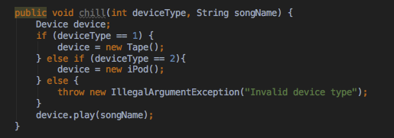
Factory
What You want to do
Create a different type depending on a condition
Wrong approach
Write a method which creates a different object based on a input parameter

Slide 6
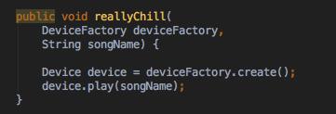
Factory
Factory Pattern
Benefits
Code readability
Low coupling
Extendibility
Notes:
Often used with objects pooling and lazy factory (not in BA since beans are reused with Spring)

Slide 7
Factory – Chilling Guy example

Slide 8
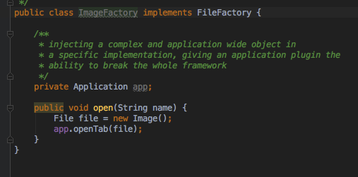
Factory Method – Simple Framework
What You want to do
Create a factory which performs some common (complex or sensitive) work contextually to the object creation
Wrong approach
Do the sensitive, complex job inside the specific object factory

Slide 9
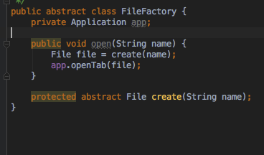
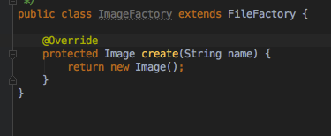
Factory Method – Simple Framework
Factory Method Pattern
Benefit
Hide framework complexity
Extensibility

Slide 10
Factory Method – Files Reader Application example

Slide 11
Singleton
What You want to do
Create a class which will be instantiate only once and globally visibile over the whole application
Wrong approach
Leave the single instance creation to the developer good sense
Pass the only created instance around

Slide 12
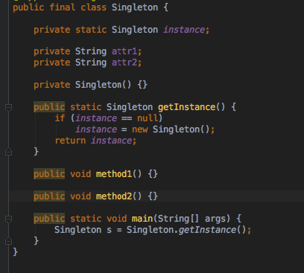
Singleton

Slide 13
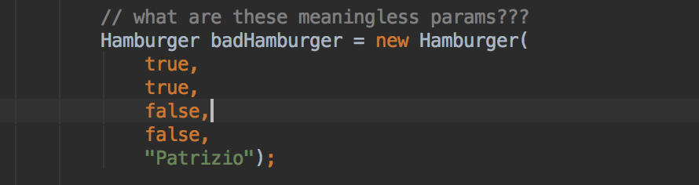
Builder
What I want to do
You want to build an immutable object
The class has more than an handful of parameters (Joshua Bloch states in Effective Java, 2nd Edition)
Wrong approach (from a design patterns point of view)
Final class without set methods
All parameters passed via the Constructor

Slide 14
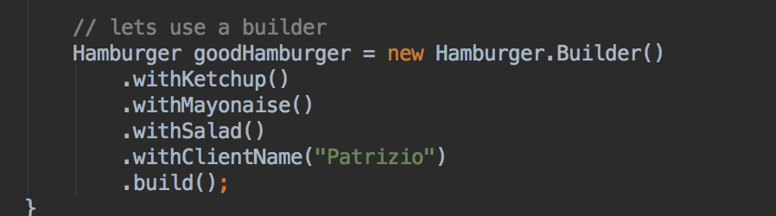
Builder
Design Pattern approach
Builder Pattern
Benefits
Separate the construction of a complex object from its representation so that the same construction process can create different representations.
Expressive and fluent interface
Notes:
Often used with a factory

Slide 15
Builder – Hamburger example

Slide 16
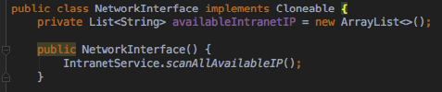
Prototype
What You want to do
Create multiple objects with mostly the same data.
Create objects which have a potentially expensive initialization overhead.
Wrong approach

Slide 17
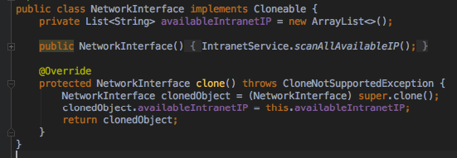
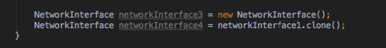
Prototype
Benefit
It eliminates the overhead of initializing an object
It simplifies and optimize the use case where multiple objects of the same type will have mostly the same data

Slide 18
Prototype – Network Interfaces example

Slide 19
Structural Design Patterns
Creational | Structural | Behavioral
Factory | Adapter | Template Method
Factory Method | Bridge | Command
Singleton | Composite | Mediator
Builder | Decorator | Observer
Prototype | Proxy | Interpreter
 | Facade | Chain of Responsibility
 | Flyweight | Strategy
 |  | Memento
 |  | State
 |  | Iterator
 |  | Visitor
Notes:
Adapter Match interfaces of different classes
Bridge Separates an object’s interface from its implementation
Composite A tree structure of simple and composite objects
Decorator Add responsibilities to objects dynamically
Proxy An object representing another object
Facade A single class that represents an entire subsystem
Flyweight A fine-grained instance used for efficient sharing
Rules of thumb
1. Adapter makes things work after they're designed; Bridge makes them work before they are.
2. Adapter provides a different interface to its subject. Proxy provides the same interface. Decorator provides an enhanced interface.
3. Composite and Decorator have similar structure diagrams, reflecting the fact that both rely on recursive composition to organize an open-ended number of objects.
4. Decorator is designed to let you add responsibilities to objects without subclassing. Composite's focus is not on embellishment but on representation. These intents are distinct but complementary. Consequently,Composite and Decorator are often used in concert.
5. Decorator and Proxy have different purposes but similar structures. Both describe how to provide a level of indirection to another object, and the implementations keep a reference to the object to which they forward requests.
6. Mediator is similar to Facade in that it abstracts functionality of existing classes. Mediatorabstracts/centralizes arbitrary communication between colleague objects, it routinely "adds value", and it is known/referenced by the colleague objects. In contrast, Facade defines a simpler interface to a subsystem, it doesn't add new functionality, and it is not known by the subsystem classes.

Slide 20
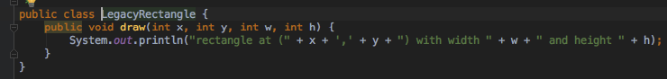
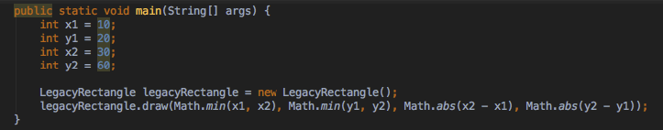
Adapter
What You want to do
An "off the shelf" component offers compelling functionality that you would like to reuse, but its "view of the world" is not compatible with the philosophy and architecture of the system currently being developed.
Wrong approach

Slide 21
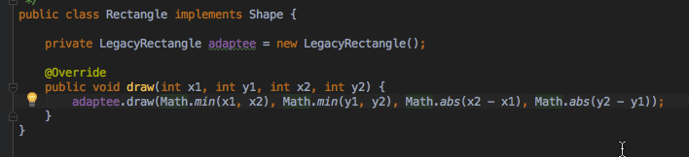
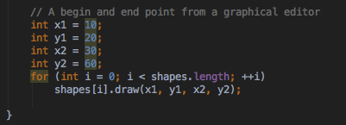
Adapter
Benefit
Convert the interface of a class into another interface clients expect. Adapter lets classes work together that couldn't otherwise because of incompatible interfaces.
The Adapter's "extra level of indirection" takes care of mapping a user-friendly common interface to legacy-specific peculiar interfaces.

Slide 22
Adapter

Slide 23
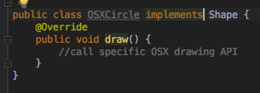
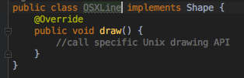
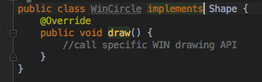
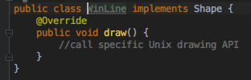
Bridge
What You want to do
Provide a class implementation that works on different platforms
Wrong approach
Implement a different class for each supported platform

Slide 24
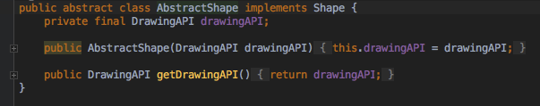
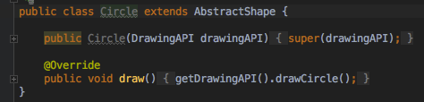
Bridge
Right Approach
Decouple the abstraction from its implementation so that the two can vary independently
Create the abstraction base class that "has a" platform object and delegates the platform-oriented functionality to it.
Define specializations of the abstraction class if desired.
Notes:
Bridge is designed up-front to let the abstraction and the implementation vary independently. Adapter is retrofitted to make unrelated classes work together.

Slide 25
Bridge – Drawing API example

Slide 26
Bridge - UML
Notes:
The bridge pattern is often confused with the adapter pattern, but that’s because they both use a wrapper to decouple abstraction and implementation, but the concepts behind them are very different

Slide 27
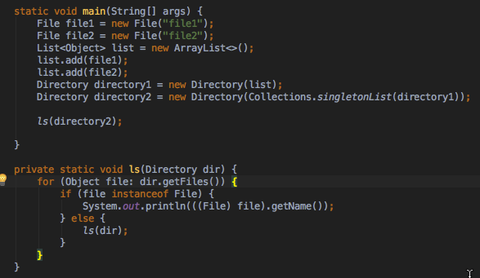
Composite
What You want to do
Compose objects into tree structures to represent whole-part hierarchies.
Wrong approach
Processing of a primitive object is handled one way, and processing of a composite object is handled differently, querying the "type" of each object before attempting to process it.
Notes:
Composite lets clients treat individual objects and compositions of objects uniformly.

Slide 28
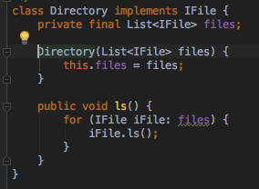
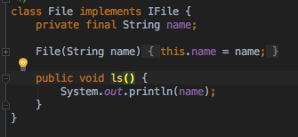
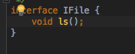
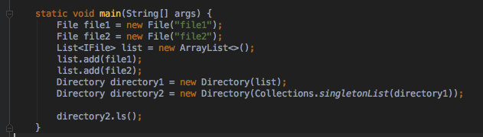
Composite
Right Approach
Define an abstract base class (Component) that specifies the behavior that needs to be exercised uniformly across all primitive and composite objects. Subclass the Primitive and Composite classes off of the Component class.
Consider the heuristic, "Containers that contain containees, each of which could be a container."
Notes:
Use this pattern whenever you have "composites that contain components, each of which could be a composite".
Divide your domain concepts into container classes, and containee classes.Create a "lowest common denominator" interface that makes your containers and containees interchangeable. It should specify the behavior that needs to be exercised uniformly across all containee and container objects.
All container and containee classes declare an "is a" relationship to the interface.
All container classes declare a one-to-many "has a" relationship to the interface.Container classes leverage polymorphism to delegate to their containee objects.

Slide 29
Composite – Directory files listing example

Slide 30
Composite – UML
Notes:
Composite and Decorator have similar structure diagrams, reflecting the fact that both rely on recursive composition to organize an open-ended number of objects.
Composite can let you compose a Mediator out of smaller pieces through recursive composition.Decorator is designed to let you add responsibilities to objects without subclassing.
Composite's focus is not on embellishment but on representation. These intents are distinct but complementary. Consequently, Composite and Decorator are often used in concert.

Slide 31
Decorator
What You want to do
Attach additional responsibilities to an object dynamically
Wrong approach
Define multiple subclasses for extending functionalities
Notes:
Composite lets clients treat individual objects and compositions of objects uniformly.

Slide 32
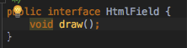
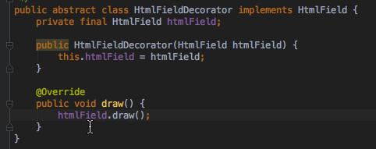
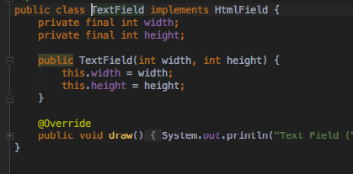
Decorator
Right Approach
Give the client the ability to specify whatever combination of "features" is desired.
Encapsulate the original object inside an abstract wrapper interface. Both the decorator objects and the core object inherit from this abstract interface. The interface uses recursive composition to allow an unlimited number of decorator "layers" to be added to each core object.
Notes:
Note that this pattern allows responsibilities to be added to an object, not methods to an object's interface. The interface presented to the client must remain constant as successive layers are specified.
Also note that the core object's identity has now been "hidden" inside of a decorator object. Trying to access the core object directly is now a problem.

Slide 33
Decorator – HTML fields decorator example

Slide 34
Decorator – UML

Slide 35
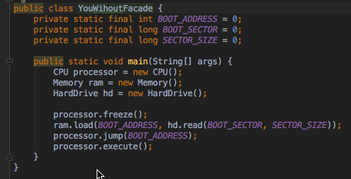
Façade
What You want to do
Interact with a complex subsystem, made of multiple even dependent modules
Wrong approach
Leave to the client the burden of interacting in the right way with the complexity of subsystems.

Slide 36
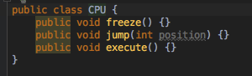
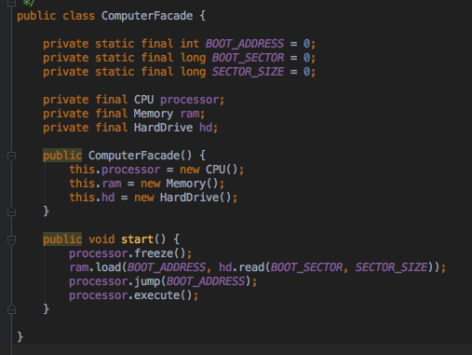
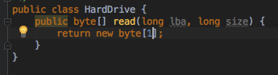
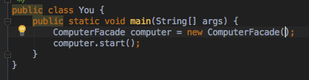
Façade
Right Approach
Provide a unified interface to a set of interfaces in a subsystem. Facade defines a higher-level interface that makes the subsystem easier to use.
Wrap a complicated subsystem with a simpler interface.
Notes:
Note that this pattern allows responsibilities to be added to an object, not methods to an object's interface. The interface presented to the client must remain constant as successive layers are specified.
Also note that the core object's identity has now been "hidden" inside of a decorator object. Trying to access the core object directly is now a problem.

Slide 37
Façade – Computer example

Slide 38
Façade – UML
Notes:
Facade defines a new interface, whereas Adapter uses an old interface. Remember that Adapter makes two existing interfaces work together as opposed to defining an entirely new one.
Whereas Flyweight shows how to make lots of little objects, Facade shows how to make a single object represent an entire subsystem.
Mediator is similar to Facade in that it abstracts functionality of existing classes. Mediator abstracts/centralizes arbitrary communications between colleague objects. It routinely "adds value", and it is known/referenced by the colleague objects. In contrast, Facade defines a simpler interface to a subsystem, it doesn't add new functionality, and it is not known by the subsystem classes.

Slide 39
Proxy
What You want to do
Access an object in either an intelligent or complex way.
Wrong approach
Leave to the client the burden of accessing the object in the right way.

Slide 40
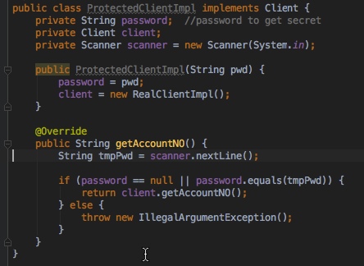
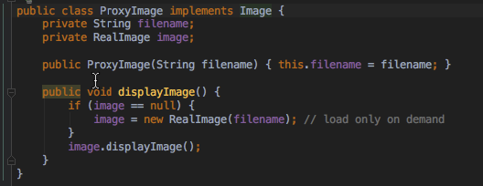
Proxy
Right Approach
Use a proxy to simply forward the call to the real object, or providing additional logic. For the client, usage of a proxy object is similar to using the real object, because both implement the same interface.
Common Scenario
Remote Proxy
Virtual Proxy
Protection Proxy
Notes:
A proxy, in its most general form, is a class functioning as an interface to something else. The proxy could interface to anything: a network connection, a large object in memory, a file, or some other resource that is expensive or impossible to duplicate. In short, a proxy is a wrapper or agent object that is being called by the client to access the real serving object behind the scenes. Use of the proxy can simply be forwarding to the real object, or can provide additional logic. In the proxy extra functionality can be provided, for example caching when operations on the real object are resource intensive, or checking preconditions before operations on the real object are invoked. For the client, usage of a proxy object is similar to using the real object, because both implement the same interface.

Slide 41
Proxy - Examples
Remote Proxy
Virtual Proxy
Protection Proxy
BookingApp - AvailablePaymentFactoryProxy class

Slide 42
Proxy - UML
Notes:
Adapter provides a different interface to its subject.
Proxy provides the same interface.
Decorator provides an enhanced interface.

Slide 43
Flyweight
Designing objects down to the lowest levels of system "granularity" provides optimal flexibility, but can be unacceptably expensive in terms of performance and memory usage.
Each "flyweight" object is divided into two pieces:
the state-dependent (extrinsic) part.
the state-independent (intrinsic) part, stored (shared) in the Flyweight object
Structure
Flyweights are stored in a Factory's repository.
The client restrains herself from creating Flyweights directly, and requests them from the Factory.
Any attributes that would make sharing impossible must be supplied by the client
Flyweight object must be immutable

Slide 44
Flyweight - Coffee Shop Example

Slide 45
Flyweight - UML

Slide 46
Structural Design Patterns – Rules of thumb
Adapter makes things work after they're designed; Bridge makes them work before they are.
Adapter provides a different interface to its subject. Proxy provides the same interface. Decorator provides an enhanced interface.
Composite and Decorator have similar structure diagrams, reflecting the fact that both rely on recursive composition to organize an open-ended number of objects.
Decorator is designed to let you add responsibilities to objects without sub-classing. Composite's focus is not on embellishment but on representation. These intents are distinct but complementary. Consequently, Composite and Decorator are often used in concert.

Slide 47
Structural Design Patterns – Rules of thumb
Decorator and Proxy have different purposes but similar structures. Both describe how to provide a level of indirection to another object, and the implementations keep a reference to the object to which they forward requests.
Mediator is similar to Facade in that it abstracts functionality of existing classes. Mediator abstracts/centralizes arbitrary communication between colleague objects, it routinely "adds value", and it is known/referenced by the colleague objects. In contrast, Facade defines a simpler interface to a subsystem, it doesn't add new functionality, and it is not known by the subsystem classes.

Slide 48
Behavioral Design Patterns
Creational | Structural | Behavioral
Factory | Adapter | Chain of Responsibility
Factory Method | Bridge | Command
Singleton | Composite | Iterator
Builder | Decorator | Mediator
Prototype | Proxy | Memento
 | Facade
 | Flyweight | Observer
 |  | State
 |  | Strategy
 |  | Template Method
 |  | Visitor
 |  | Interpreter
Notes:
Chain of responsibility
A way of passing a request between a chain of objects
Command
Encapsulate a command request as an object
Interpreter
A way to include language elements in a program
Iterator
Sequentially access the elements of a collection
Mediator
Defines simplified communication between classes
Memento
Capture and restore an object's internal state
Observer
A way of notifying change to a number of classes
State
Alter an object's behavior when its state changes
Strategy
Encapsulates an algorithm inside a class
Template method
Defer the exact steps of an algorithm to a subclass
Visitor
Defines a new operation to a class without change

Slide 49
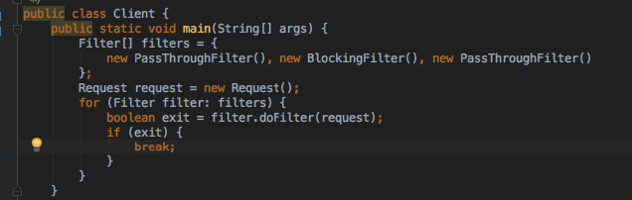
Chain of responsibility
What You want to do
We want to process a request with a list of Handlers
Wrong approach
The client is responsible for stepping through the "list" of Handler objects, and determining when the request has been handled.

Slide 50
Chain of responsibility
Right Approach
Avoid coupling the sender of a request to its receiver by giving more than one object a chance to handle the request.
Encapsulate the processing elements inside a "pipeline" abstraction; and have clients "launch and leave" their requests at the entrance to the pipeline.
Instead of senders and receivers maintaining references to all candidate receivers, each sender keeps a single reference to the head of the chain, and each receiver keeps a single reference to its immediate successor in the chain.
Make sure there exists a "safety net" to "catch" any requests which go unhandled.
Notes:
The pattern chains the receiving objects together, and then passes any request messages from object to object until it reaches an object capable of handling the message.
The number and type of handler objects isn't known a priori, they can be configured dynamically.
The chaining mechanism uses recursive composition to allow an unlimited number of handlers to be linked.
Chain of Responsibility simplifies object interconnections. Instead of senders and receivers maintaining references to all candidate receivers, each sender keeps a single reference to the head of the chain, and each receiver keeps a single reference to its immediate successor in the chain.
Make sure there exists a "safety net" to "catch" any requests which go unhandled.
Do not use Chain of Responsibility when each request is only handled by one handler, or, when the client object knows which service object should handle the request.

Slide 51
Chain of Responsibility - Example
Notes:
Chain of Responsibility PASM example: AbstractPaymentOptionPostProcessor

Slide 52
Chain of Responsibility - UML

Slide 53
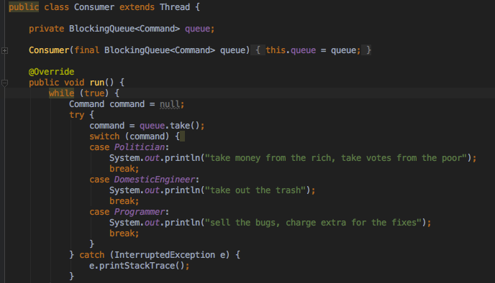
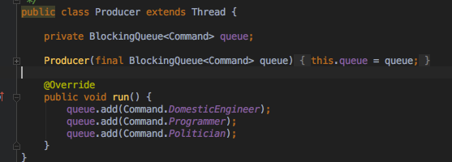
Command
What You want to do
Execute a list of operations
Wrong approach
The client sequentially executes all the operations
Despite you decoupled the producer with the consumer, the latter needs to know the details of the operation (coupling)

Slide 54
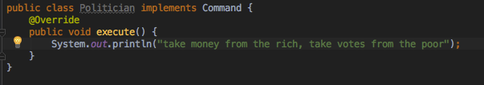
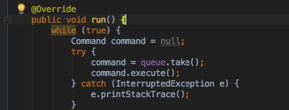
Command
Right Approach
Encapsulate all the info needed to execute the operation into the operation object itself
The operation becomes a black box to the consumer which provides only the resources to execute it (CPU, memory, etc) but not the logic.
Since the operation objects are independent from the producer and the consumer they can be re-used.
Notes:
Command objects can be thought of as "tokens" that are created by one client that knows what need to be done, and passed to another client that has the resources for doing it.
MacroCommands can be implemented with Composite.

Slide 55
Command - Example
Notes:
Chain of Responsibility PASM example: AbstractPaymentOptionPostProcessor

Slide 56
Command - UML
Notes:
Chain of Responsibility PASM example: AbstractPaymentOptionPostProcessor

Slide 57
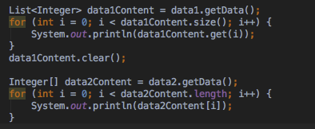
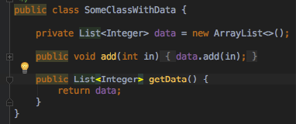
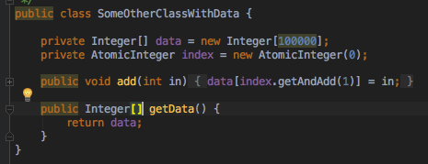
Iterator
What You want to do
Provide the possibility to traverse different data structures
Wrong approach
Provide access to the internal structure of data structures
Provide a specific traversal implementation for each data structure

Slide 58
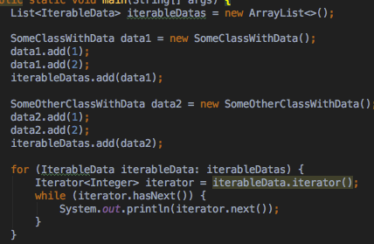
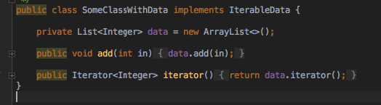
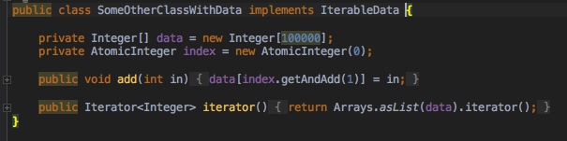
Iterator
Right approach
Give the possibility to traverse the elements without exposing the internal structure
Abstract the traversal logic from the client

Slide 59
Iterator - UML
Notes:
Chain of Responsibility PASM example: AbstractPaymentOptionPostProcessor

Slide 60
Mediator
What You want to do
Build a many-to-many relationship among a number of peers
Design reusable components
Wrong approach
"spaghetti code" phenomenon. Trying to scoop a single serving results in an "all or nothing clump".
Wrong Approach Example

Slide 61
Mediator
Right Approach
Define an object that encapsulates how a set of objects interact.
Design an intermediary to decouple many peers.
Right Approach Example
Notes:
Promotes loose coupling by keeping objects from referring to each other explicitly, and it lets you vary their interaction independently.

Slide 62
Mediator - UML
Notes:
Chain of Responsibility PASM example: AbstractPaymentOptionPostProcessor

Slide 63
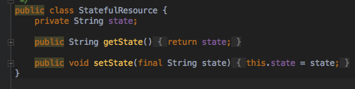
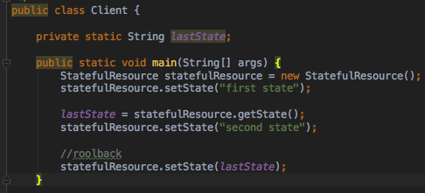
Memento
What You want to do
Need to restore an object back to its previous state (e.g. "undo" or "rollback" operations).
Wrong approach
The client of the object knows how to save and restore the state of the object.
The client knows the internal of the object (coupling)
Notes:
Coupling: if we modify the statefull object later we need to modify also the clients which utilies it.

Slide 64
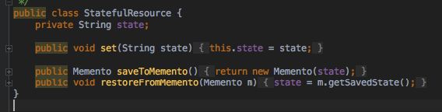

Memento
Right Approach
The client requests a memento (state holder) to the object, so that this memento can be returned back to the object later.
Only the object knows how produce and restore its state, using the memento.
Notes:
Promotes loose coupling by keeping objects from referring to each other explicitly, and it lets you vary their interaction independently.

Slide 65
Memento - UML
Notes:
Promotes loose coupling by keeping objects from referring to each other explicitly, and it lets you vary their interaction independently.

Slide 66

Observer
What You want to do
Define a one-to-many dependency between objects so that when one object changes state, all its dependents are notified and updated automatically.
Wrong approach
Monolithic design
The client modifying the object state also notifies the dependents
Coupling

Slide 67
Observer
Right approach
Define an object that is the "keeper" of the data model and/or business logic (the Subject).
Observers register themselves with the Subject as they are created. Whenever the Subject changes, it broadcasts to all registered Observers the change of status and the observer get the modification (Pull protocol).
This allows the number and "type" of "view" objects to be configured dynamically (Low coupling)
Right Approach Example
Notes:
Pull Protocol vs Push Protocol

Slide 68
Observer - UML

Slide 69
References
https://sourcemaking.com/design_patterns
Add wikipedia pages

